Slide 1

Accessibility Through Technical Writing Principles
A Practical Guide
Copyright 2024 Starship Equity LLC

Slide 2
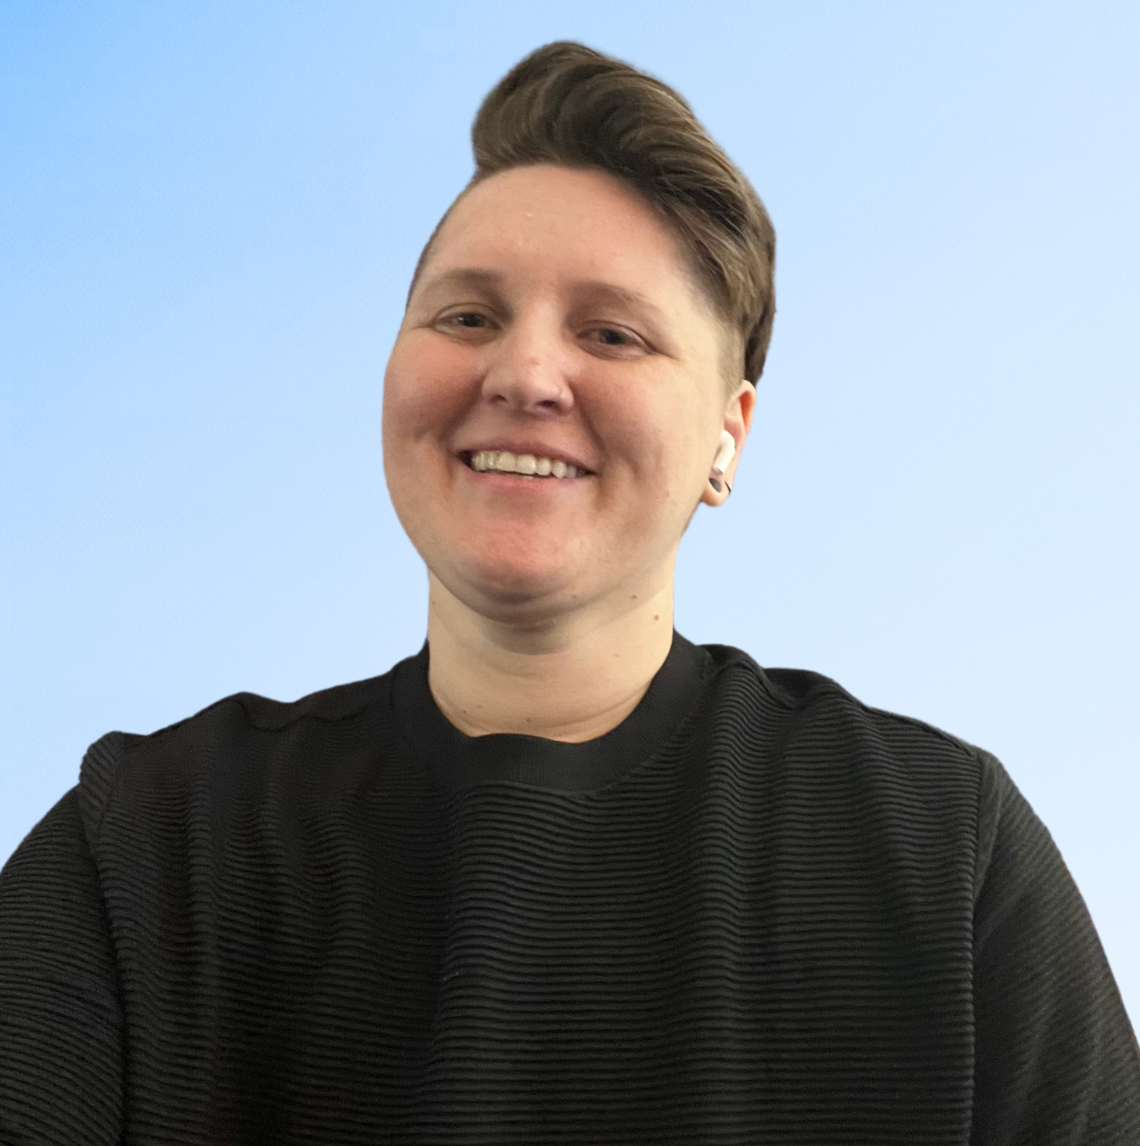
Maddie Reardon (all pronouns)
10+ years: Technical Content
8+ years: Chronic Illness
32+ years: Neurodivergent
Copyright 2024 Starship Equity LLC

Slide 3
01
Five Principles of Technical Writing
Today’s Targets
02
How They Connect to Accessibility
03
How to Apply Them
Copyright 2024 Starship Equity LLC
Notes:
We’re doing to discuss the 5 principles of technical writing, how they connect and partner with accessibility, and actions you can start taking immediately after this.

Slide 4

WCAG
Perceivable
Operable
Understandable
Robust
Easy for all users to use and comprehend.
Copyright 2024 Starship Equity LLC
Notes:
Understandable information and user interface:
Text is readable and understandable
Content appears and operates in predictable ways
Users are helped to avoid and correct mistakes

Slide 5
Technical Writing Principles
  Clear
  Concise
  Consistent
  Correct
  Complete
Copyright 2024 Starship Equity LLC

Slide 6
Clear
Present Tense
Active Voice
Plain Language
Copyright 2024 Starship Equity LLC
Notes:
Text is readable and understandable (POUR):
- "Identifying the language of text passages, phrases, or other parts of a web page"
- "Providing definitions for any unusual words, phrases, idioms, and abbreviations"
- "Using the clearest and simplest language possible, or providing simplified versions"

Slide 7
Before:
Assignments should be submitted on Canvas. Late submissions will be subject to penalty.
Clear
After:
Submit your assignments on Canvas. We deduct points for late work.
Copyright 2024 Starship Equity LLC
Notes:
"should" implies uncertainty.
future tense, like “will,” can also imply uncertainty.

Slide 8
Concise
Essential info only
Avoid long sentences
Copyright 2024 Starship Equity LLC

Slide 9
Before:
Late submissions will be subject to penalty, and extensions must be requested in writing and approved by the instructor prior to the due date. Failure to adhere to these guidelines may result in a reduction of the final grade.
Concise
After:
We deduct points for late work. If you need more time, ask your instructor in writing before the due date.
Copyright 2024 Starship Equity LLC
Notes:
If a sentence can't be easily read in one breath, consider shortening it or breaking it into two sentences.
What info is necessary, and what info is extraneous.

Slide 10
Consistent
Terminology
Phrasing
Formatting
Copyright 2024 Starship Equity LLC
Notes:
Use the same terminology, phrasing, formatting.

Slide 11
Before:
Coursework should be submitted via the online portal.
Submit assignments on Canvas.
Papers should be submitted to Canvas.
Assignments can be submitted on the online portal.
Consistent
After:
Submit assignments on Canvas.
Copyright 2024 Starship Equity LLC
Notes:
Slight differences can potentially cause confusion. Someone might think, “Are they using this term interchangeably, or are they referring to something else?”
Other times, variations in terminology/phrasing can imply different meanings to different people. “Should submit” sounds like there’s wiggle room; “Submit” sounds certain.

Slide 12
Correct
Fact Check
Proofread
Copyright 2024 Starship Equity LLC
Notes:
Fact check:
In technical writing, we walk through the steps.
If you're writing assignment instructions, walk through the steps. Is the info still up-to-date?
Screenshots up to date? UI (e.g. location of a button) can change often.
Proofread:
Peer review.
Take a break, come back a couple hours or days later to proofread.

Slide 13
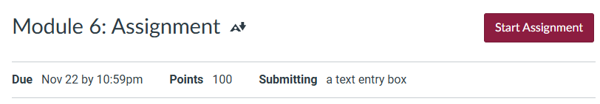
Before:
Submit the module 6 assignment by clicking the Submit button on the assignment page.
Correct
After:
Submit the module 6 assignment by clicking the Start Assignment button on the assignment page.
Copyright 2024 Starship Equity LLC
Notes:
In technical writing, the use of screenshots and demo videos are used sparingly because they are challenging to keep update-to-date. Software is always changing, so especially in online learning environments, it's important to regularly check for accuracy in case anything needs to be updated. Outdated instructions and screenshots can cause confusion, and end up doing more harm than good.
Consider:
Screenshots on Canvas modules still up to date?
Locations and dates all still accurate?
Are dates listed in multiple places? Do they match?

Slide 14
Complete
All info and context that audience needs
Copyright 2024 Starship Equity LLC
Notes:
The "Complete" principle in technical writing ensures that all necessary information is provided without omitting crucial details. This principle is especially important for accessibility as it helps all users, including those with various disabilities, to fully understand the content without needing to seek additional clarification.
This includes supplemental information or content, such as videos and screenshots. Did you add alt text? Video transcript?
Is the information provided on the page(s) where one would expect to find it.

Slide 15
Before:
Submit your final project on Canvas. Late submissions will lose points.
Complete
After:
Submit your final project on Canvas by May 15, 2025 at 11:59 PM MT.
  File format: PDF only, maximum size 20MB
  Late policy: 10% deduction per day late, up to 3 days.
Copyright 2024 Starship Equity LLC
Notes:
Knowing your audience is essential.
What info does the other person/persons need, and have you provided it to them?

Slide 16
Thank You
Maddie's LinkedIn
Maddie's Newsletter
Copyright 2024 Starship Equity LLC

