Slide 1
Accessible Social Media
Kathy Marks
IT Accessibility Coordinator
links.asu.edu/soc-med

Slide 2
Topics
How accessible is social media?
Make your account/profile more accessible
Make your posts more accessible

Slide 3
How accessible is social media?

Slide 4
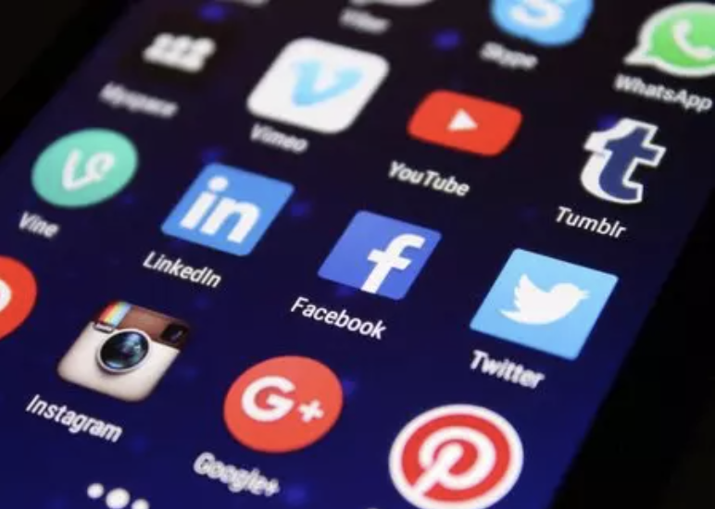
The importance of social media
Social media is a major means of:
Communication
Collaboration
Reviews & opinions
Brand monitoring
Entertainment
Media sharing
Political activity & news reporting

Slide 5
Why does accessibility matter?
3.81 billion
active social media users (49% of population)
20-26%
of them have a disability

Slide 6
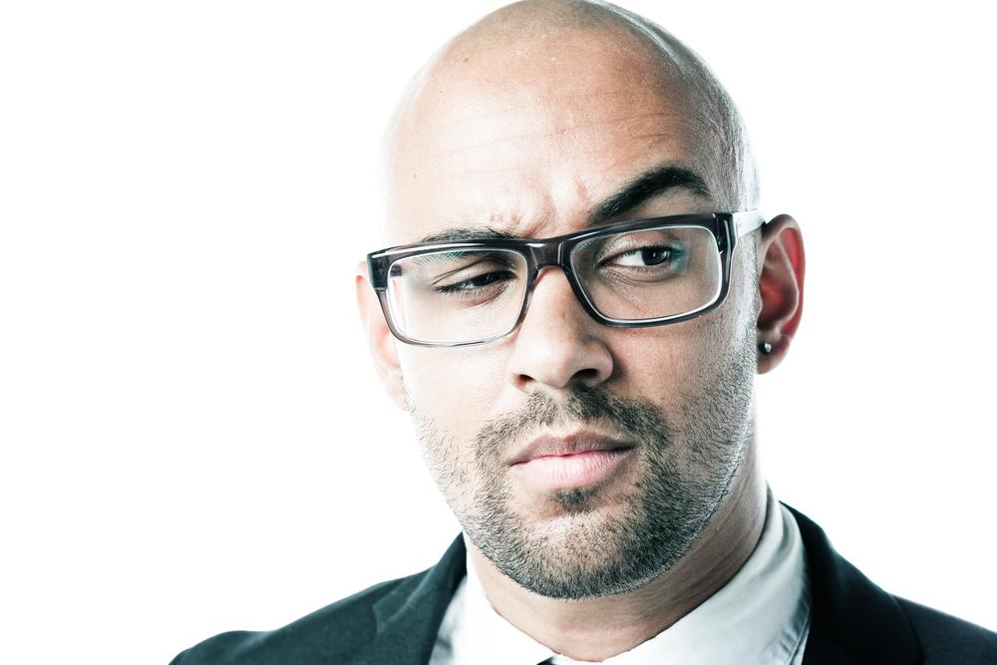
Is social media accessible?
Of 1,695 respondents to a 2017 WebAIM screen reader survey:
14.9% found it accessible
54.3% found it somewhat accessible
29.4% found it somewhat or very inaccessible

Slide 7
Test results for popular platforms
 | Facebook | Instagram | LinkedIn | Pinterest | Twitter | YouTube
Keyboard | ✔ | 🗶 | 🗶 | 🗶 | 🗶 | 🗶
No autoplay | 🗶 | 🗶 | 🗶 | 🗶 | 🗶 | 🗶
Autoplay in settings | ✔ | 🗶 | ✔ | 🗶 | ✔ | 🗶
Video can be paused | ✔ | 🗶 | ✔ | 🗶 | 🗶 | ✔
Page titles | 🗶 | ✔ | 🗶 | 🗶 | ✔ | ✔
Headings | 🗶 | 🗶 | 🗶 | 🗶 | 🗶 | 🗶
Forms | 🗶 | 🗶 | 🗶 | 🗶 | 🗶 | 🗶
ARIA / HTML | 🗶 | 🗶 | 🗶 | 🗶 | 🗶 | 🗶
From accessibilityoz.com

Slide 8
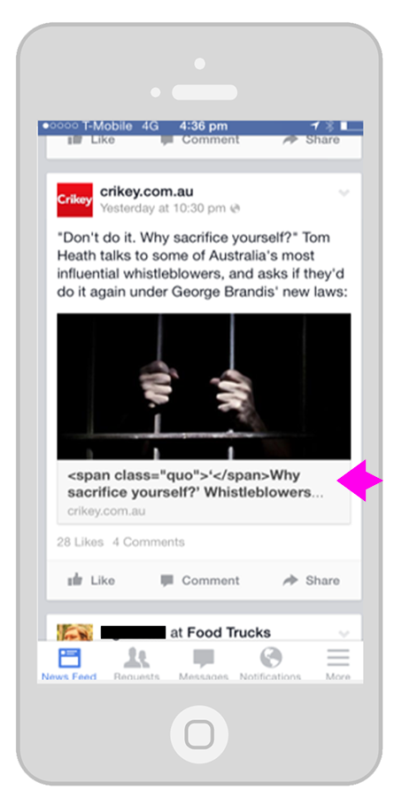
Why isn’t social media more accessible?
#1 reason: Rapid changes in technology.

Slide 9
Make your account/profile more accessible

Slide 10
Make your account accessibility friendly.
Provide your contact information on your media page.
Post to multiple social media outlets.
Use multiple communication channels.
Highlight alternative apps.
Point out the platform's accessibility tips.

Slide 11
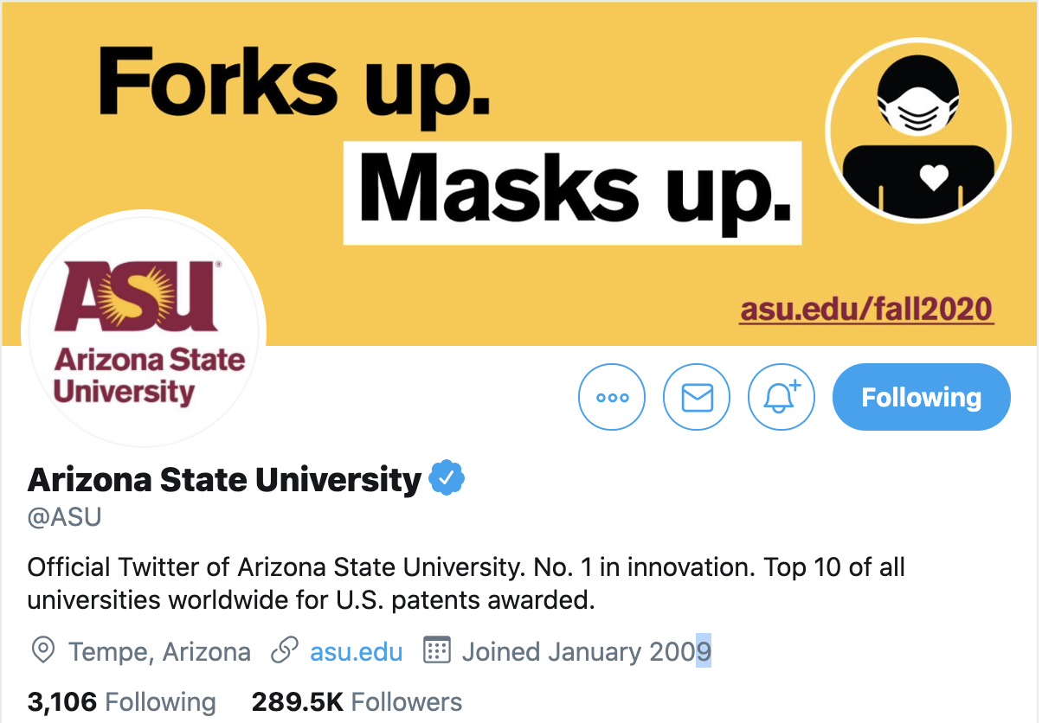
Provide your contact info
Prominently display your contact information on your main social media page.
Provide an email address and phone number where a user can contact you with questions if the platform allows.
For example, in Twitter, a short description is allowed with a location and URL.

Slide 12
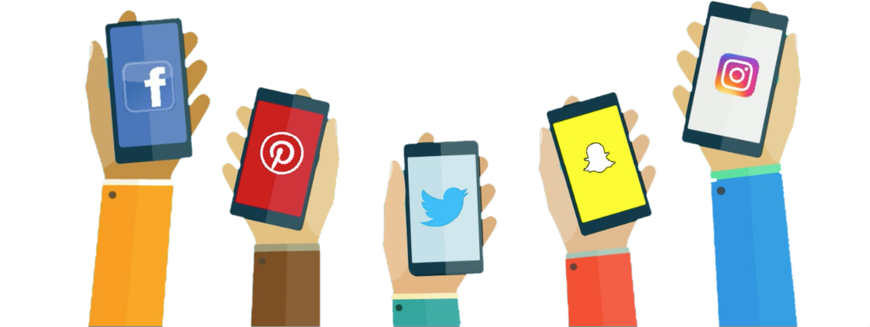
Post to multiple social media platforms.
Different users find different social media apps accessible. Make sure to post to a variety to reach as many users as possible.

Slide 13
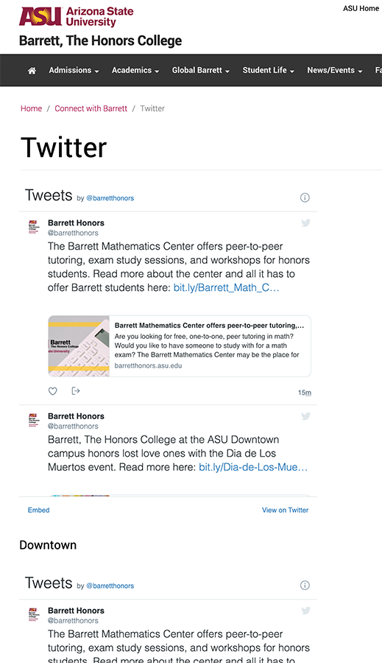
Use multiple communication channels.
Provide your social media feed on your website or via email.
An HTML version of your feed may be more accessible for some people.
Provide your feed via email and offer options for weekly and daily digests.

Slide 14
List alternative apps that are more accessible .
Point out alternative apps that may be more accessible.
Facebook
The mobile view of Facebook
Metal for Android
YouTube
Accessibility for YouTube Android mobile app
YouDescribe for desktop or iOS
Twitter
EasyChirp
Twitterrific on Mac
Twitterrific on iOS
Metal for Android
LinkedIn
LinkedIn Lite for Android

Slide 15
Point out the platform's accessibility tips
Highlight accessibility tips and give links to help pages.
Facebook
Facebook Accessibility Page
Facebook Accessibility Tips
Which screen reader should I use for Facebook?
Instagram: How do I use a screen reader for Instagram?
LinkedIn: Accessibility for All
Twitter: Accessibility Tips on Twitter
YouTube: Use YouTube with a screen reader

Slide 16
Make your posts more accessible

Slide 17
How to create accessible posts.
Write accessible content:
Use CamelCase hashtags.
Limit hashtags and add them only to the end.
Avoid misspellings.
Avoid abbreviations.
Use a URL shortener.
Use good color contrast in images.
Caption your videos.
Add or edit image alternative text.

Slide 18
1. Write accessible content.
Write accessible posts:
Use CamelCase hashtags: #FIFIWorldCup2022 or #ArizonaStateUniversity
Limit hashtags and add them only to the end.
Avoid misspellings.
Avoid abbreviations.
Use a URL shortener like links.asu.edu or bitly.com
Listen to JAWS read this URL: https://video.ibm.com/recorded/128470152U

Slide 19
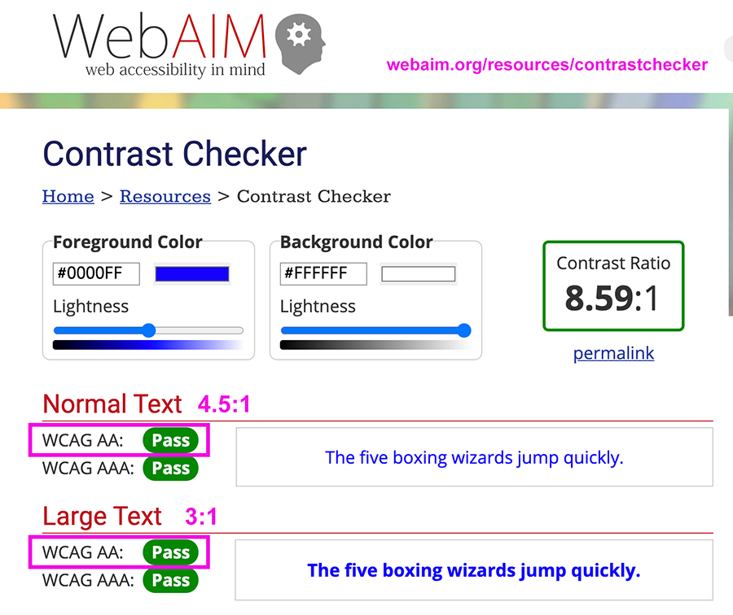
2. Use good color contrast in images.

Slide 20
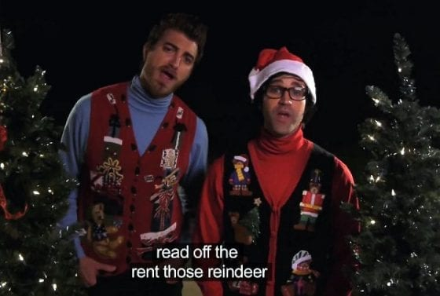
3. Caption your videos.
Some social media platforms will auto-caption your video, but always be sure to edit captions for accuracy.
Some platforms will only allow you to upload a caption file created elsewhere.
If neither option is available, burn captions into the video.

Slide 21
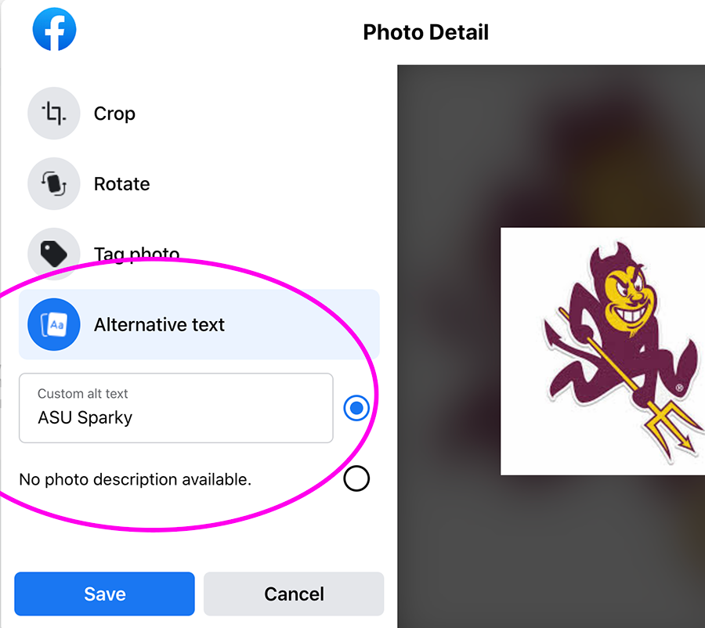
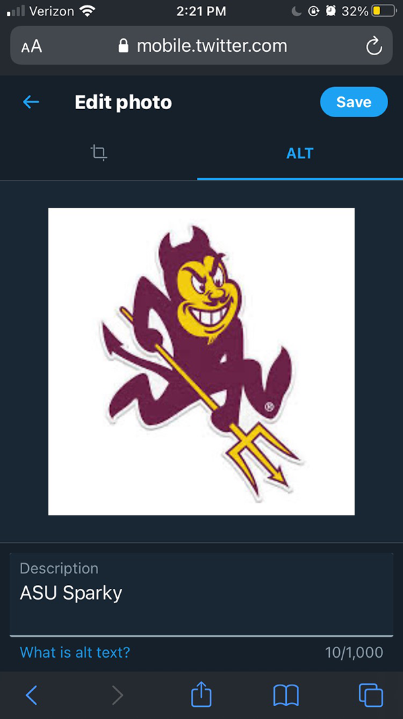
4. Add or edit image alternative text.

Slide 22
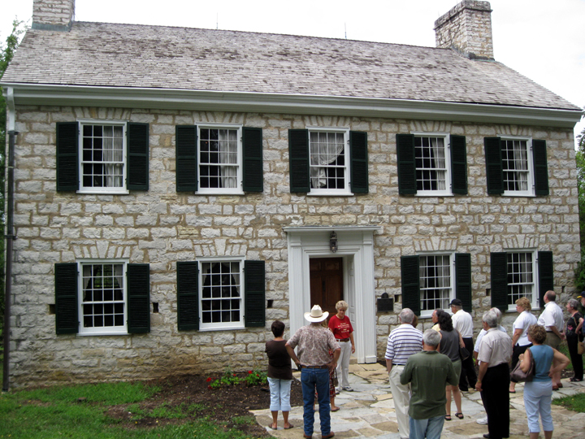
Write good alt text: Context is everything.
What is most important for the context?

Slide 23
Write good alt text: Text in images
Your alt text should be the same as the graphic text, word for word.
In this case, the alt text should be “Hayden 50 - Celebrating our past, building our future.”

Slide 24
Decorative images

Slide 25
Decorative images

Slide 26
Decorative images

Slide 27
Questions?
Get help at:
webaccessibility.asu.edu
Slack #accessibility channel
webaccessibility@asu.edu

