Slide 1
Reaching Everyone: Accessibility in Communications and Event Planning
Adero C E Allison, PhD
Assistant Director EOSS - DRC
Kathy Marks
Web Accessibility Specialist - UTO

Slide 2
What are some reasons that we plan events?
Notes:
Get thoughts from the group. Let this lead into the ASU Design Aspirations.
Point out the discrepancy between inviting people to attend the providing inaccessible content.
If people cannot access the information shared, the purpose of the event is undermined.

Slide 3
ASU Design Aspirations
1 - Empower student success
5 - Leverage our place
6 - Be socially engaged
8 - Transform Society

Slide 4
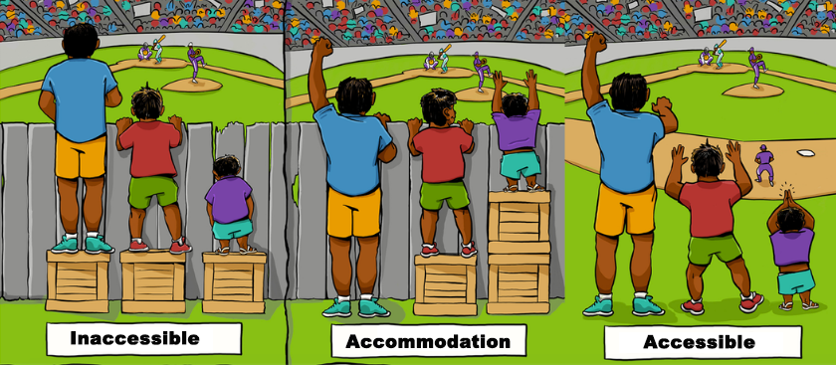
Accommodation and Accessibility

Slide 5
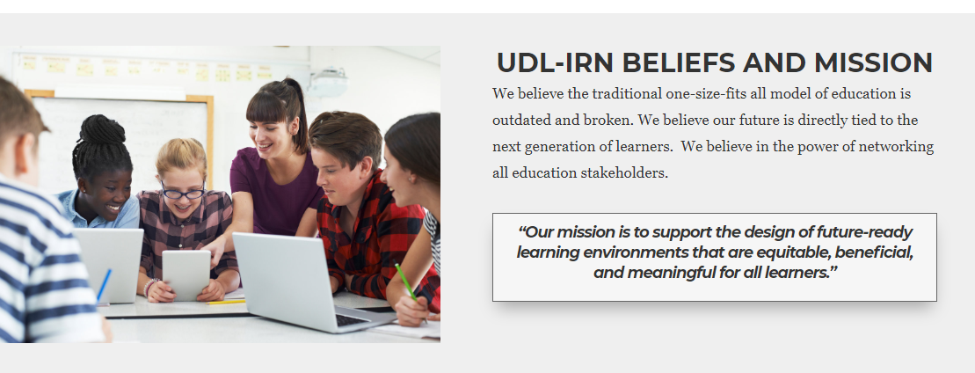
https://udl-irn.org/

Slide 6
Universal Design in Learning
Information and Research Network (UDL-IRN)
Four Critical Elements
Clear-Goals
Intentional Planning for Learner Variability
Flexible Methods and Materials
Timely Progress Monitoring
https://udl-irn.org/
Notes:
These are not the principles of universal design but instead they demonstrate ways to think about designing communications and events to meet the needs of the broadest audience.
Universal Design is an ATTITUDE - GOAL - PROCESS that can benefit everyone.

Slide 7
So, Let’s Plan An Event
Notes:
Brainstorm

Slide 8

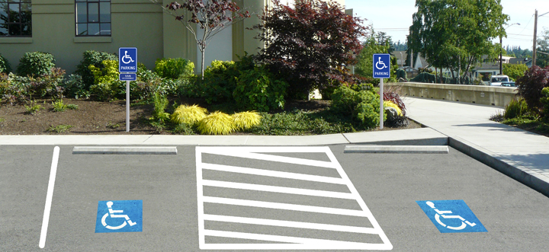
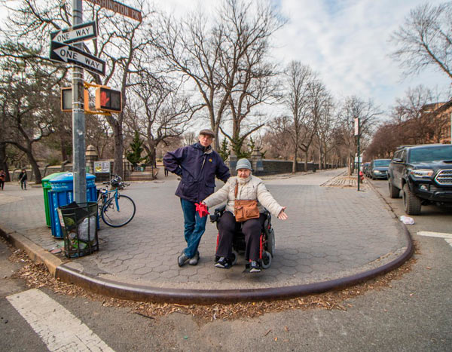

UD and the built environment
Assistive > Listening system in place
< Accessibility Parking
< Fingers reading braille Toilet sign
Man & women > wheel chair user at crosswalk with no curb cut.

Slide 9

Digital Access
Email
Website
Social media
PowerPoint

Slide 10
Caption all videos.
54%
of university students use captions at least some of the time
Top tips for captioning video:
Use YouTube to auto-generate captions for your videos, then edit them.
If you upload the video to other platforms: download the caption.srt file from YouTube and upload it to the new platform.
Get more tips at http://links.asu.edu/a11y-video

Slide 11
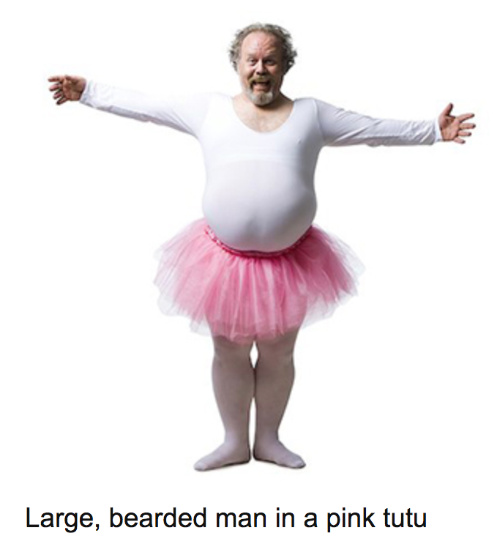
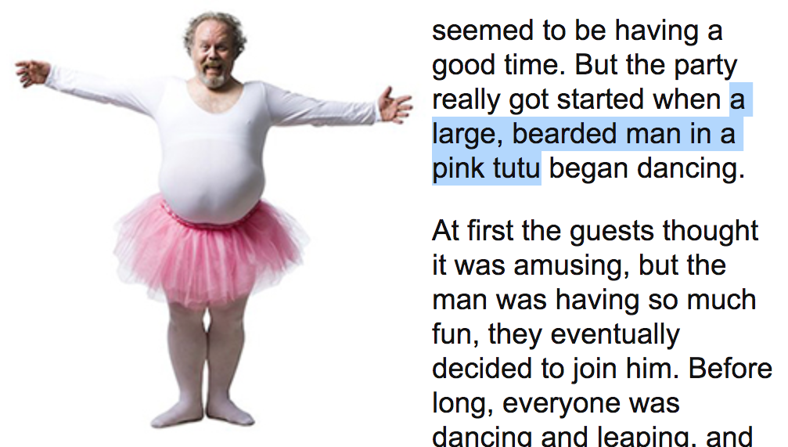
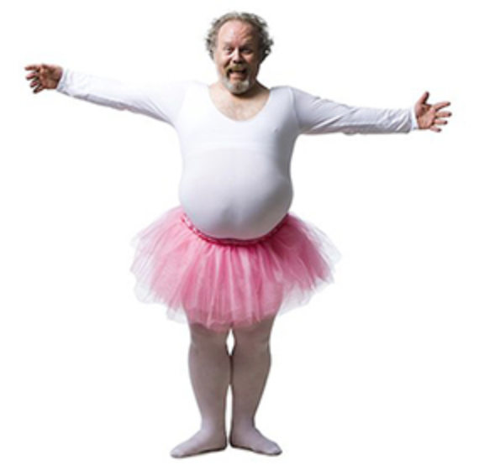
Add alternative text
1. Caption
<img src=”tutu.jpg” alt=””>
<caption>Large bearded man in pink tutu</caption>
2. In content
<img src=”tutu.jpg” alt=””>
3. ALT tag
<img src=”tutu.jpg” alt=”Large bearded man in pink tutu”>

Slide 12
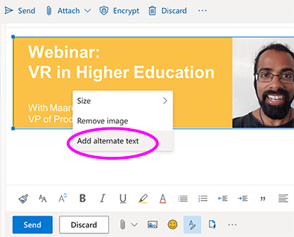
Email
Top tips to make email accessible:
If you use tables for layout, add role="presentation" on the <table> element.
Add alternative text to all meaningful images. Add NULL alt text to decorative images.
Get more tips at http://links.asu.edu/a11y-email

Slide 13
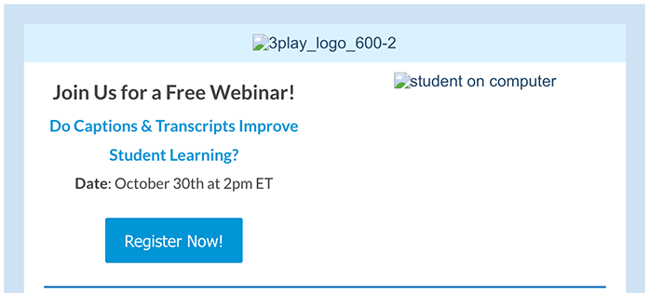
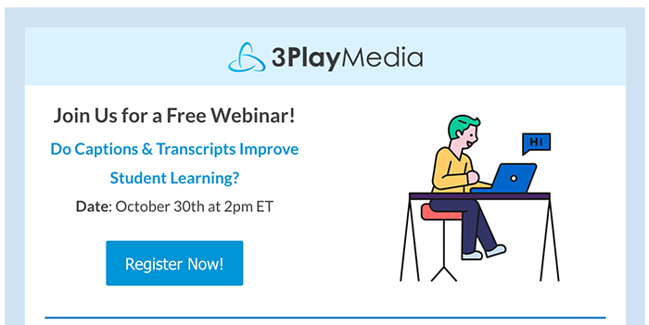
What’s good ALT text? - example 1

Slide 14
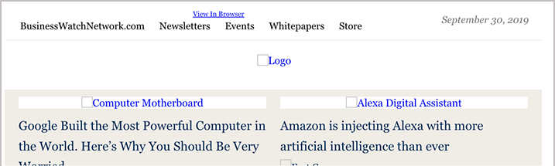
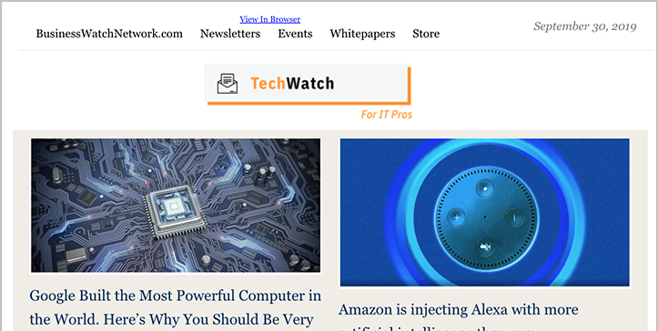
What’s good ALT text? - example 2

Slide 15
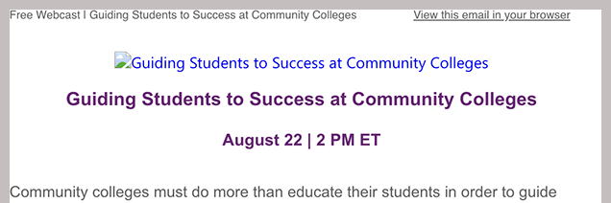
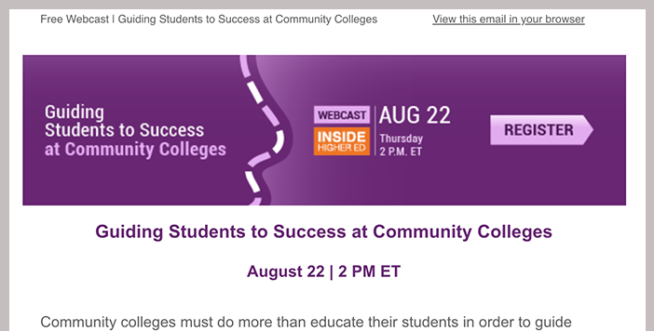
What’s good ALT text? - example 3

Slide 16
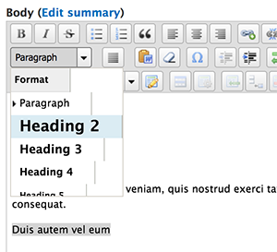
Website
Top tips to make websites accessible:
Use headings to structure content.
Make sure all pages are keyboard accessible.
Animation stops after 5 seconds or includes a pause button.
Get more tips at https://webaccessibility.asu.edu

Slide 17
Social media
Top tips to make social media accessible:
Make hashtags accessible.
Use a URL shortener.
Put hashtags and mentions at bottom of posts.
Get more tips at http://links.asu.edu/a11y-media
#CamelCaseIsBetter

Slide 18
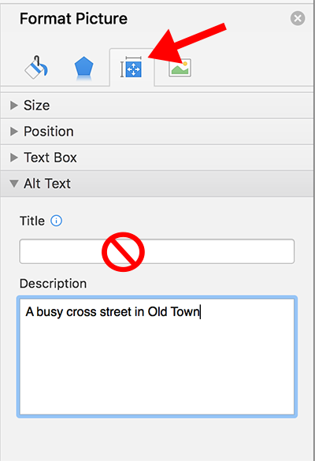
PowerPoint
Top tips to make PowerPoints accessible:
Use the default layouts.
Use default slide titles.
Build charts and data tables within PowerPoint.
Get more tips at http://links.asu.edu/a11y-ppt

Slide 19
Engagement Access
What are some of the factors involved in learning?

Slide 20
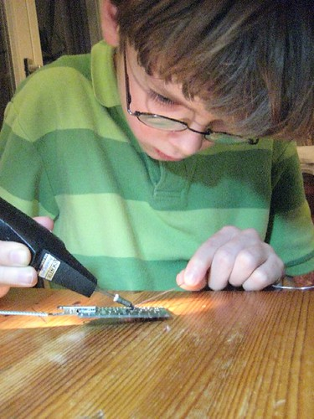
Memory Learning Recall
Young boy with > glasses carefully hot gluing a model
"IMG_2348" by maltman23 is licensed under CC BY-SA 2.0
Notes:
Cognition - Memory, Learning, Recall
Sensation - Vision, Hearing, Touch, Smell, Taste
Integration - Sensory, Environmental, Societal

Slide 21

Taste, Touch, > Smell, Hear, See
"Five Senses - Altered Book" by Oliver Lo is licensed under CC BY-NC-ND 4.0
Notes:
Sensation - See, Hear, Touch, Smell, Taste

Slide 22
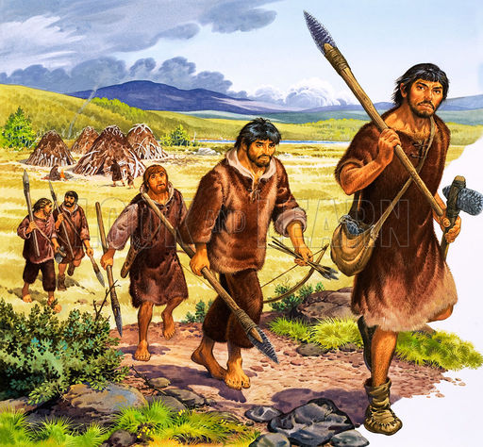
Environment Society Mobility
IMG Creator:Unknown © Look and Learn Information extracted from IPTC Photo Metadata
Notes:
Integration - Environment, Society, Mobility

Slide 23
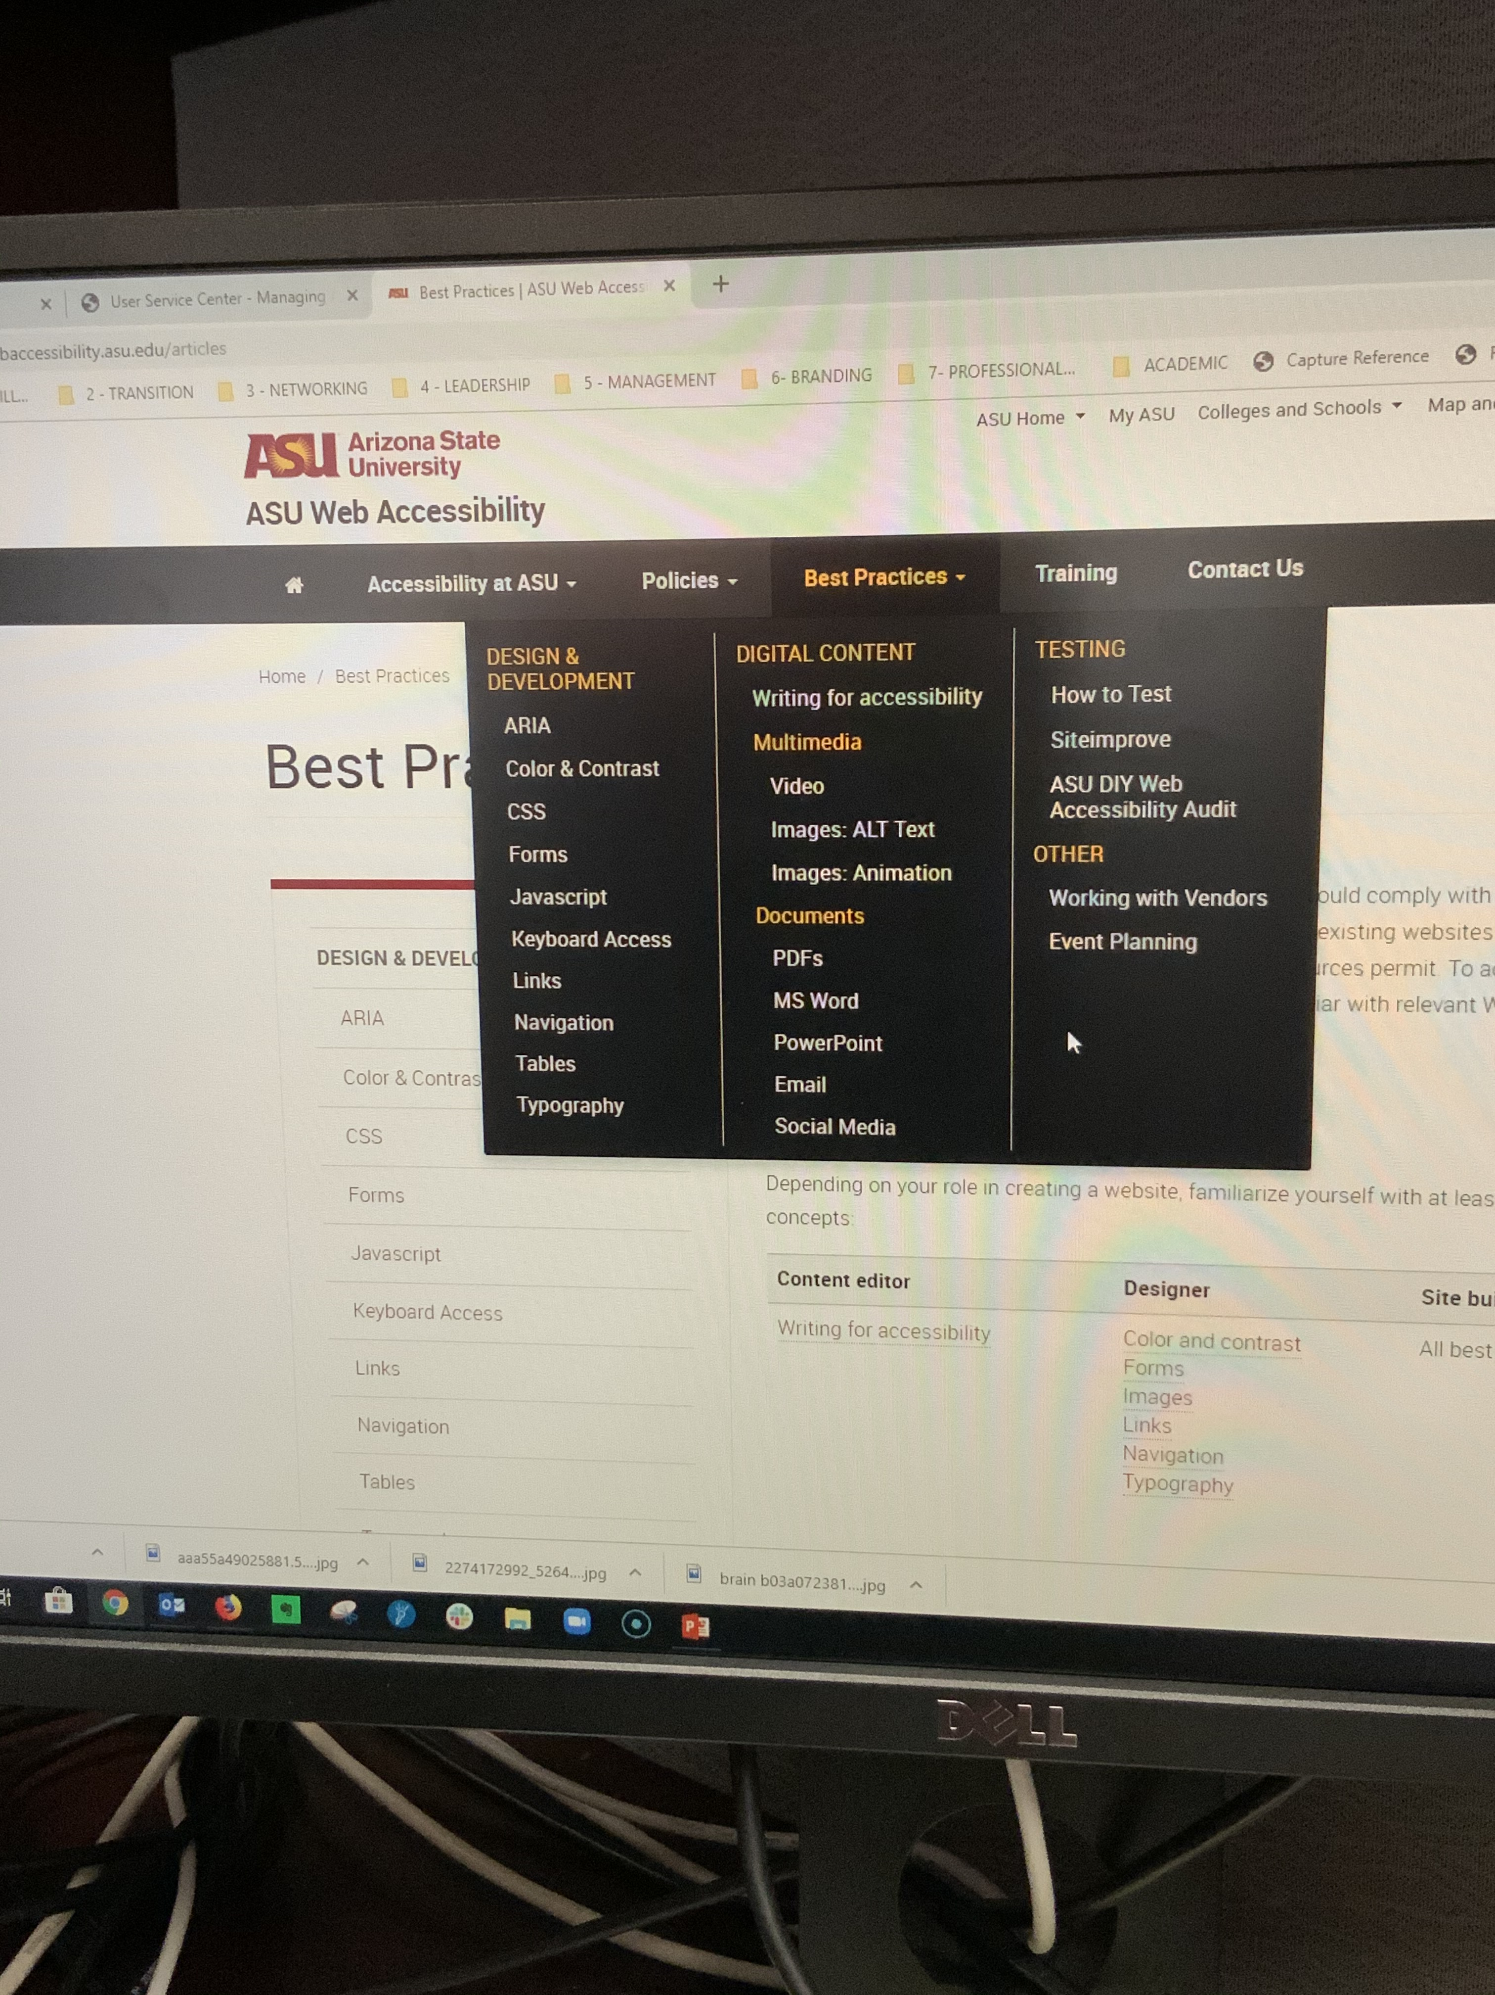
ASU Web Accessibility
ASU Accessibility web > page with BEST PRACTICES menu open
https://webaccessibility.asu.edu/articles

Slide 24
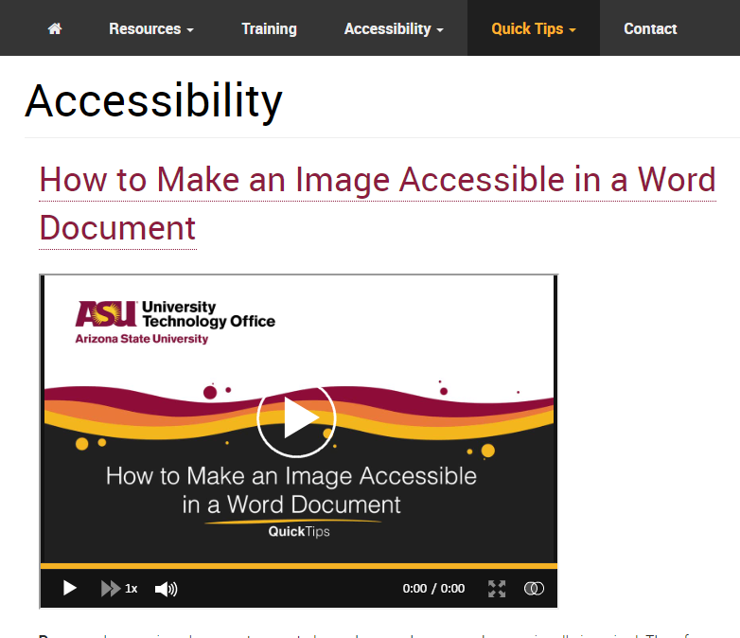
ASU LMS Accessibility
ASU LMS Accessibility web > page showing one of several accessible content creation training videos
https://webaccessibility.asu.edu/articles

Slide 25
Discussion

Slide 26
Resources
ASU Web Accessibility https://webaccessibility.asu.edu/articles
ASU Accessibility Project - Join or request a speaker - Accessibility@ASU.edu
Universal Design in Learning Information and Research Network Http://udl-irn.org
ASU’s LMS Training videos https://lms.asu.edu/Accessibility

